Slide 1

Unit-2 ASP.NET Controls
Web Programming using ASP.NET (ASP.NET)
DU # 2105CS311
Prof. Madhuresh R Fichadiya
Computer Engineering Department
madhuresh.fichadiya@darshan.ac.in
8866961282

Slide 2

Looping
Outline
Introduction to ASP.NET Controls
Standard Controls
List Controls
Validation Controls

Slide 3
Introduction to ASP.NET Controls

Slide 4
Introduction to ASP.NET Controls
The ASP.NET controls used to design the interface of a web application.(For Example, Textbox, Label, Button etc.)
ASP.NET provides a standard set of controls that can be used to develop web applications.
The System.Web.UI.Control namespace is the base class for all web server controls.
The standard web form controls are inherited from a common base class namely System.Web.UI.WebControls class.

Slide 5
ASP.NET Controls
Standard Controls
Label Control
Literal Control
TextBox Control
Button Control
CheckBox Control
RadioButton Control
HyperLink Control
Image Control
FileUpload Control
LinkButton Control
ImageButton Control
HiddenField Control
List Controls
DropDownList
CheckBoxList
ListBox
RadioButtonList
BulletedList
Validation Controls
RequiredFieldValidator
CompareValidator
RangeValidator
RegularExpressionValidator
CustomValidator
ValidationSummary

Slide 6
Standard Controls

Slide 7
Label Control
Label Control is used to display the static or dynamic text on web page that cannot be changed by user.
The syntax for creating any web server control is:
<asp:control_name id=“some_id” runat=“server” />
Example:
<asp:Label ID=“lblMessage" runat="server" Text="Enter Your Name"></asp:Label>

Slide 8
Common Properties
Property | Description
ID | Identifier for the control
Runat | indicates that the form should be processed on the server
Text | to specify or determine the text of control
CssClass | CSS class
Height | Height in pixels or %
Width | Gets or sets the width of the Web server control
AutoPostBack | the mechanism by which the page will be posted back to the server automatically based on some events
Visible | It indicates whether a server control is visible
Enabled | Indicates whether the control is enabled or not
ToolTip | Gets or sets the text displayed when the mouse pointer hovers over the web server control

Slide 9
Literal Control
The Literal control is used to display text on a page. The text is programmable.
This control does not let you apply styles to its content.
Example
<asp:Literal ID="ltlMessage" runat="server" Text="Literal Control Example"></asp:Literal>

Slide 10
TextBox Control
The TextBox control is an input control which can be used to accept user input.
Example:
<asp:TextBox ID="txtUserName" runat="server" ReadOnly="true" MaxLength="10" TextMode="SingleLine"
Text="Darshan Institute of Engineering & Technology">
</asp:TextBox>
<asp:TextBox ID="txtClgName" runat="server" TextMode="MultiLine" Rows="3"
Text="Darshan University is a leading university offering undergraduate, graduate and post graduate
programs.”>
</asp:TextBox>

Slide 11
Button Control
A Button Control accepts clicks and performs other actions on the user interface of web page.
Example:
<asp:Button ID="btnSave" runat="server" Text="Submit"></asp:Button>

Slide 12
Example – Button Control
Drag and drop two textbox, label and button on your web form.
<div>
<table>
<tr>
<td><asp:TextBox ID=“txtNo1" runat="server" /></td>
<td> + </td>
<td><asp:TextBox ID=“txtNo2" runat="server" /></td>
</tr>
<tr>
<td><asp:Button ID=“btnAddition" runat="server" OnClick="btnAddition_Click" Text="Addition" /></td>
</tr>
</table>
</div>

Slide 13

Example – Button Control – Cont..
protected void btnAddition_Click (object sender, EventArgs e)
{
Double Num1 = Convert.ToDouble(txtNo1.Text);
Double Num2 = Convert.ToDouble(txtNo2.Text);
Double Ans = Num1 + Num2;
lblAnswer.Text = “Addition is ” + Ans.ToString();
}
Output:

Slide 14

CheckBox Control
A CheckBox control is used to select a single or multiple options from the available choices.
It Represent a choice that can be only Yes(checked) or No(Unchecked) value.
Example
<asp:CheckBox ID="chkMusic" runat="server" Text="Music" />
<asp:CheckBox ID="chkCricket" runat="server" Text="Cricket" />
<asp:CheckBox ID="chkReading" runat="server" Text="Reading" />

Slide 15
Example - CheckBox Control
<table>
<tr>
<td>
<asp:CheckBox ID="chkMusic" runat="server" Text="Music" />
<asp:CheckBox ID="chkCricket" runat="server" Text="Cricket" />
<asp:CheckBox ID="chkReading" runat="server" Text="Reading" />
</td>
<td>
<asp:Button ID="btnHobbies" runat="server" Text="Show Hobbies" OnClick="btnHobbies_Click" />
</td>
<td>
<asp:Label Text="" ID="lblHobbies“ runat="server” />
</td>
</tr>
</table>

Slide 16
Example - CheckBox Control Cont..
protected void btnHobbies_Click(object sender, EventArgs e)
{
if (chkCricket.Checked == true)
lblHobbies.Text = chkCricket.Text;
if (chkMusic.Checked == true)
lblHobbies.Text += chkMusic.Text;
if (chkReading.Checked == true)
lblHobbies.Text += chkMusic.Text;
}
Output:

Slide 17

RadioButton Control
RadioButton Control is similar to checkbox control.
It allows us to select only one option from available options.
Radio Buttons are grouped together using GroupName property.
Example:
<asp:RadioButton ID="rbMale" runat="Server" Text="Male" GroupName="Gender" />
<asp:RadioButton ID="rbFemale" runat="Server" Text="Female" GroupName="Gender" />

Slide 18
Example – RadioButton Control
<table>
<tr>
<td>
<asp:RadioButton ID="rbMale" runat="Server" Text="Male" GroupName="Gender" />
<asp:RadioButton ID="rbFemale" runat="Server" Text="Female" GroupName="Gender" />
</td>
<td>
<asp:Button ID="btnGender" runat="server" Text="Show Gender" OnClick="btnGender_Click" />
</td>
<td>
<asp:Label Text="" ID="lblGender" runat="server"></asp:Label>
</td>
</tr>
</table>

Slide 19
Example – RadioButton Control
protected void btnGender_Click(object sender, EventArgs e)
{
if (rbMale.Checked == true)
lblGender.Text = rbMale.Text.ToString();
else if (rbFemale.Checked == true)
lblGender.Text = rbFemale.Text.ToString();
else
lblGender.Text = "Kindly Select Gender";
}
Output:
Output:

Slide 20

HyperLink Control
Hyperlink control is used to jump to another location.
It is useful when you want to display a link to a site.
Example
<asp:HyperLink ID="hlGoogle" runat="server" Target="_blank" NavigateUrl=“https://www.google.com”
Text="Go to Google.com" />

Slide 21

Image Control
Image control is used to place an image on the web page.
It is used when displaying products, user profile photo etc.
Example
<asp:Image ID="imgUser" runat="server" ImageUrl="~/user.png" AlternateText="This is Profile Picture" />

Slide 22

FileUpload Control
FileUpload control allows users to upload file to the webserver.
Once the server receives the posted file data, the application can save it, check it, or ignore it.
Required Namespace for uploading file is using System.IO.
Example:
<asp:FileUpload ID="fuFile" runat="server" />

Slide 23
FileUpload Control Properties
Some properties of File Upload Control are as follow:
Property | Description
FileBytes | Gets an array of the bytes in a file that is specified by using a FileUpload control
FileContent | Gets a Stream object that points to a file to upload using the FileUpload control
FileName | Gets the name of a file on a client to upload using the FileUpload control.
HasFile | Gets a value indicating whether the FileUpload control contains a file

Slide 24
Example – FileUpload Control
<div>
<asp:FileUpload ID="fuFile" runat="server" />
<hr />
<asp:Button ID="btnUpload" Text="Upload" runat="server" OnClick="UploadFile" />
<br />
<asp:Label ID="lblMessage" ForeColor="Green" runat="server" />
</div>

Slide 25
Example – FileUpload Control – Cont..
protected void UploadFile(object sender, EventArgs e)
{
string folderPath = Server.MapPath("~/Files/");
//Check whether Directory (Folder) exists.
if (!Directory.Exists(folderPath))
{
//If Directory (Folder) does not exists. Create it.
Directory.CreateDirectory(folderPath);
}
//Save the File to the Directory (Folder).
fuFile.SaveAs(folderPath + Path.GetFileName(fuFile.FileName));
//Display the success message.
lblMessage.Text = Path.GetFileName(fuFile.FileName) + " has been uploaded.";
}

Slide 26
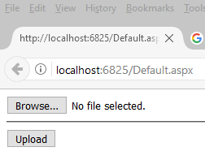
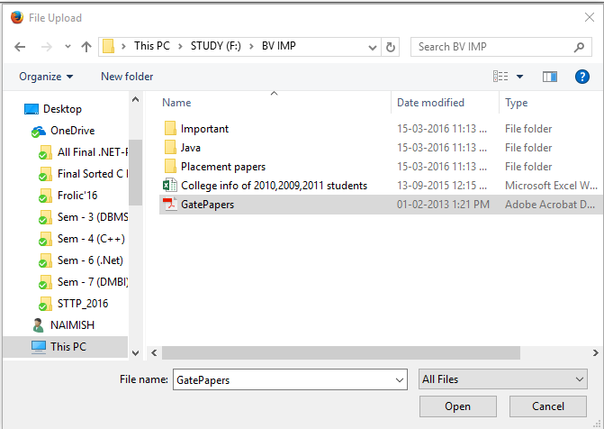
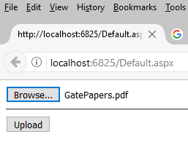
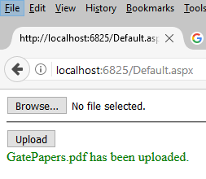
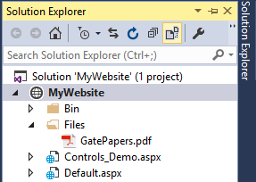
Output – FileUpload Control

Slide 27

LinkButton Control
LinkButton control is used to create a hyperlink button.
This control looks like a HyperLink control but has the same functionality as the Button control.
Example
<asp:LinkButton ID="lnkbtnLogout" runat="server" Text="Logout" />

Slide 28

ImageButton Control
ImageButton control is used to display a clickable image.
The properties of the Image control can also be used on the ImageButton control.
Example
<asp:ImageButton ID="imgbtnUser" runat="server" ImageUrl="~/user.png"/>

Slide 29

HiddenField Control
HiddenField, as name implies, is hidden that means non visual control in ASP.NET where you can save the value.
Anyone can see HiddenField details by simply viewing the source of document.
HiddenFields are not encrypted or protected and can be changed by any one, from a security point of view, this is not suggested. ASP.NET uses HiddenField control for managing the ViewState.
So, don’t store any important or confidential data like password and credit card details with this control.
Example
<asp:HiddenField ID="hfDate" runat="server" />

Slide 30
List Controls

Slide 31
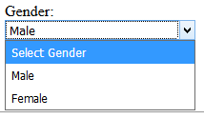
DropDownList Control
DropDownList control is used to give a single select option to the user from multiple listed items.
You can add its option items by directly writing into .aspx page directly or dynamically add at run time or bind through database.
Example
<asp:DropDownList ID="ddlGender" runat="server" Width="200px"> <asp:ListItem Text="Select Gender" Value="0"></asp:ListItem> <asp:ListItem Text="Male" Value="1"></asp:ListItem> <asp:ListItem Text="Female" Value="2"></asp:ListItem>
</asp:DropDownList>

Slide 32
Properties of DropDownList Controls
Some of the properties of DropDownList Control is as follows:
Property | Description
SelectedValue | Get the value of the selected item from the dropdown list.
SelectedIndex | Gets the index of the selected item from the dropdown list.
SelectedItem | Gets or sets the selected logical list item.
Items | Gets the collection of items from the dropdown list.
DataTextField | Name of the data source field to supply the text of the items. (No need to set when you are adding items directly into .aspx page.)
DataValueField | Name of the data source field to supply the value of the items. (No need to set when you are adding items directly into .aspx page.)

Slide 33
Example – DropDownList Control
<h3>How to use Dropdown list</h3>
<div>
<label>Gender:</label>
<br />
<asp:DropDownList ID="ddlGender" runat="server" Width="200px">
<asp:ListItem Text="Select Gender" Value="0"></asp:ListItem>
<asp:ListItem Text="Male" Value="1"></asp:ListItem>
<asp:ListItem Text="Female" Value="2"></asp:ListItem>
</asp:DropDownList>
</div>
<div>
<asp:Button ID="btnSubmit" runat="server" Text="Click to Retrieve Value" OnClick="btnSubmit_Click" />
</div>
<div>
Selected Item Text:
<asp:Label ID="lblSelectedText" runat="server"></asp:Label>
</div>
<div>
Selected Item Value:
<asp:Label ID="lblSelectedValue" runat="server"></asp:Label>
</div>

Slide 34
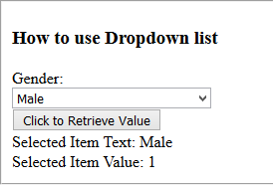
Example – DropDownList Control
Output:
protected void btnSubmit_Click(object sender, EventArgs e) {
//Retrieve Selected Text from Dropdown
lblSelectedText.Text = ddlGender.SelectedItem.Text;
//Retrieve Selected Value from Dropdown
lblSelectedValue.Text = ddlGender.SelectedValue;
}

Slide 35
CheckBoxList Control
CheckBoxList control is a control that groups a collection of checkable list items.
Example
<asp:CheckBoxList ID="cblStates" runat="server">
<asp:ListItem Text="Gujarat“" Value="Gujarat"></asp:ListItem>
<asp:ListItem Text="Maharastra" Value="Maharastra"> </asp:ListItem>
<asp:ListItem Text="Bihar" Value="Bihar"></asp:ListItem>
<asp:ListItem Text="Assam" Value="Assam"></asp:ListItem>
<asp:ListItem Text="Goa" Value="Goa"></asp:ListItem>
</asp:CheckBoxList>

Slide 36

Example – CheckBoxList Control
<div>
<fieldset>
<h3>How to use Checkbox list control</h3>
<div>
<asp:CheckBoxList ID="cblStates" runat="server">
<asp:ListItem Text="Gujarat" Value="Gujarat"></asp:ListItem>
<asp:ListItem Text="Maharastra" Value="Maharastra"></asp:ListItem>
<asp:ListItem Text="Bihar" Value="Bihar"></asp:ListItem>
<asp:ListItem Text="Assam" Value="Assam"></asp:ListItem>
<asp:ListItem Text="Goa" Value="Goa"></asp:ListItem>
</asp:CheckBoxList>
</div>
<asp:Button ID="btnShow" runat="server" Text="Submit" OnClick="btnShow_Click" />
</fieldset>
</div>
<div>
<fieldset>
<h3>Selected States:</h3>
<div>
<asp:Label ID="lblStates" runat="server"></asp:Label>
</div>
</fieldset>
</div>

Slide 37
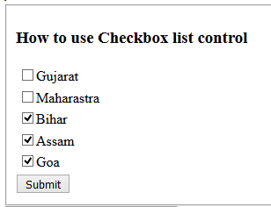
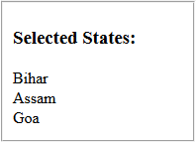
Example – CheckBoxList Control
protected void btnShow_Click(object sender, EventArgs e)
{
foreach (ListItem item in cblStates.Items)
{
if (item.Selected)
lblStates.Text += item.Text + "<br/>";
}
}
Output:

Slide 38
RadioButtonList Control
RadioButtonList control enable user to select an item from list that groups a collection of radiobuttons.
Example
<asp:RadioButtonList ID="rblRating" runat="server" RepeatDirection="Horizontal" RepeatLayout="Table">
<asp:ListItem Text="Excellent" Value="Excellent"></asp:ListItem>
<asp:ListItem Text="Very Good" Value="Very Good"></asp:ListItem>.
<asp:ListItem Text="Good" Value="Good"></asp:ListItem>
<asp:ListItem Text="Bad" Value="Bad"></asp:ListItem>
</asp:RadioButtonList>

Slide 39
Example – RadioButtonList Control
<div>
<h3>How to use Radio Button List control</h3>
<div>
<asp:RadioButtonList ID="rbtLstRating" runat="server" RepeatDirection="Horizontal" RepeatLayout="Table">
<asp:ListItem Text="Excellent" Value="Excellent"></asp:ListItem>
<asp:ListItem Text="Very Good" Value="Very Good"></asp:ListItem>
<asp:ListItem Text="Good" Value="Good"></asp:ListItem>
<asp:ListItem Text="Bad" Value="Bad"></asp:ListItem>
</asp:RadioButtonList>
</div>
<asp:Button ID="btnChoice" runat="server" Text="Submit" OnClick="btnChoice_Click" />
<h3>Selected Rating:</h3>
<div>
<asp:Label ID="lblSelectedRating" runat="server"></asp:Label>
</div>
</div>

Slide 40
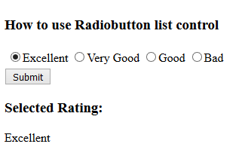
Example – RadioButtonList Control
protected void btnChoice_Click(object sender, EventArgs e)
{
if (rblRating.SelectedItem != null)
{
lblSelectedRating.Text = rbtLstRating.SelectedItem.Text;
}
}
Output:

Slide 41


ListBox Control
ListBox control is used to give a single or multiple select options to the user from multiple listed items.
Example
<asp:ListBox ID="lbColor" runat="server">
<asp:ListItem Text="Red" Value="red"></asp:ListItem>
<asp:ListItem Text="Blue" Value="blue"></asp:ListItem>
<asp:ListItem Text="Green" Value="green"></asp:ListItem>
<asp:ListItem Text="Pink" Value="pink"></asp:ListItem>
</asp:ListBox>

Slide 42
Properties of ListBox Control
Some properties of ListBox Control are as follows:
Property | Description
Rows | No. of rows (items) can be set to display in the List.
SelectionMode | Single or Multiple. If multiple, it allows user to select multiple items from the list by holding Ctrl or Shift key.
SelectedValue | Get the value of the Selected item from the List box.
SelectedIndex | Gets or Sets the index of the selected item in the List box.
SelectedItem | Gets the selected item from the list.
Items | Gets the collection of items from the List box.
DataTextField | Name of the data source field to supply the text of the items. (No need to set when you are adding items directly into .aspx page.)
DataValueField | Name of the data source field to supply the value of the items. (No need to set when you are adding items directly into .aspx page.)

Slide 43
Example – ListBox Control
<div>
<div>
<h3>How to use List Box Control</h3>
<asp:ListBox ID="lbColor" runat="server" SelectionMode="Multiple">
<asp:ListItem Text="Red" Value="red"></asp:ListItem>
<asp:ListItem Text="Blue" Value="blue"></asp:ListItem>
<asp:ListItem Text="Green" Value="green"></asp:ListItem>
<asp:ListItem Text="Pink" Value="pink"></asp:ListItem>
</asp:ListBox>
</div>
<br />
<asp:Button ID=“btnSelectedColors" runat="server" Text="Submit" OnClick="btnSelectColors_Click" />
<h3>Selected Colors:</h3>
<div>
<asp:Label ID="lblSelectedColors" runat="server"></asp:Label>
</div>
</div>

Slide 44
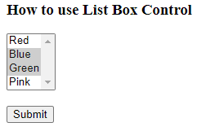

Example – ListBox Control
protected void btnSelectColors_Click(object sender, EventArgs e)
{
foreach (ListItem item in lbColor.Items)
{
if (item.Selected)
lblSelectedColors.Text += item.Text + "<br/>";
}
}
Output:

Slide 45

BulletedList Control
The BulletedList control renders either an unordered (bulleted) or ordered (numbered) list.
<div>
<asp:BulletedList ID="blstColor" runat="server" BulletStyle="Disc">
<asp:ListItem Text="Red" Value="red"></asp:ListItem>
<asp:ListItem Text="Blue" Value="blue"></asp:ListItem>
<asp:ListItem Text="Green" Value="green"></asp:ListItem>
<asp:ListItem Text="Pink" Value="pink"></asp:ListItem>
</asp:BulletedList>
</div>

Slide 46
Validation Controls

Slide 47
Validation Controls
Validation is important part of any web application. User's input must always be validated before sending across different layers of the application.
Validation controls are used to:
To validate user input data.
Data format, data type and data range is used for validation.
Validation is of two types:
Client Side
Server Side
Client side validation is good but we have to be dependent on browser and scripting language support.
Client side validation is considered convenient for users as they get instant feedback.
The main advantage is that it prevents a page from being postback to the server until the client validation is executed successfully.

Slide 48
Validation Controls Cont..
For developers point of view server side is preferable because it is not dependent on browser and scripting language.
There are different validation controls for specific types of validation in ASP.NET, such as range checking, pattern matching etc.
With client-side validation, any errors are detected on the client end when the form is submitted to the server.
If any of the validators are found to be in error, the submission of the form to the server is cancelled and the validator's ErrorMessage property is displayed.
This permits the user to correct the input before submitting the form to the server.

Slide 49
Validation Controls Cont..
Control | Description
RequiredFieldValidator | Ensures that the user does not skip an entry.
CompareValidator | Compares a user's entry with a constant value or a property value of another control using a comparison operator (less than, equal to, greater than, and so on).
RangeValidator | Checks that a user's entry is between specified lower and upper boundaries. You can check ranges within pairs of numbers, alphabetic characters, or dates. Boundaries can be expressed as constants.
RegularExpressionValidator | Checks that the entry matches a pattern defined by a regular expression. E.g. social security numbers, e-mail addresses, telephone numbers, postal codes, and so on.
CustomValidator | Checks the user's entry using validation logic that you code yourself. This type of validation allows you to check for values derived at run time.
ValidationSummary | Displays the validation errors in summary form for all of the validators on a page.

Slide 50
Common Properties : Validation Controls
Property | Description
ErrorMessage | The ErrorMessage property is commonly used to provide different messages for the validation control and the ValidationSummary control.
ControlToValidate | The programmatic ID of the input control that the validation control will evaluate. If this is not a legitimate ID, an exception is thrown.
ValidationGroup | Specifies the name of the validation group to which this validation control belongs.
IsValid | Indicates whether the input control specified by the ControlToValidate property is determined to be valid.
ForeColor | Specifies the color in which to display the inline message when validation fails.
SetFocusOnError | Indicates whether focus is set to the control specified by the ControlToValidate property when validation fails.
Display | The display behavior for the specified validation control. This property can be one of the following values:

Slide 51
Common Properties : Validation Controls Contd..
Property | Description
Display | None The validation control is never displayed inline. Use this option when you want to show the error message only in a ValidationSummary control. Static The validation control displays an error message if validation fails. Space is allocated on the Web page for the error message even if the input control passes validation. The layout of the page does not change when the validation control displays its error message. Because the page layout is static, multiple validation controls for the same input control must occupy different physical locations on the page. Dynamic Space for the error message is allocated dynamically on the page when validation fails. This allows multiple validation controls to share the same physical location on the page.

Slide 52
RequiredFieldValidation Control
The RequiredFieldValidator control is simple validation control, which checks to see if the data is entered for the input control or not.
You can have a RequiredFieldValidator control for each form element on which you wish to enforce mandatory Field rule.
Example
<asp:RequiredFieldValidator ID="rfvPassword" runat="server" ErrorMessage="Password Required“
ControlToValidate="txtPassword">
</asp:RequiredFieldValidator>

Slide 53

CompareValidator Control
The CompareValidator control allows you to make comparison to compare data entered in an input control with a constant value or a value in a different control.
It can most commonly be used when you need to confirm password entered by the user at the registration time. The data is always case sensitive.
Example
<asp:CompareValidator ID="cmpComfirmPassword" runat="server" ErrorMessage="Password Mismatch"
ForeColor="Red" ControlToValidate="txtConfirmPassword" ControlToCompare="txtPassword">
</asp:CompareValidator>

Slide 54
CompareValidator Control Cont..
Important Properties
Property | Description
Type | Specifies the data type of the values being compared.
Operator | The Operator property allows you to specify the type of comparison to perform, such as greater than, equal to, and so on.
ValueToCompare | Instead of comparing the values of two input controls, you can compare the value of an input control to a constant value. Specify the constant value to compare with by setting the ValueToCompare property.
ControlToCompare | If you want to compare a specific input control with another input control, set the ControlToCompare property with the name of the control to compare.

Slide 55
RangeValidator Control
The RangeValidator Server Control is another validator control, which checks to see if a control value is within a valid range.
The attributes that are necessary to this control are: MaximumValue, MinimumValue, and Type.
Example
<asp:RangeValidator ID="rngCPI" runat="server" ErrorMessage="CPI Must Be In 0 to 10" ForeColor="Red“
ControlToValidate="txtCPI" MaximumValue="10" MinimumValue="0">
</asp:RangeValidator>

Slide 56
RegularExpressionValidator Control
A regular expression is a powerful pattern matching language that can be used to identify simple and complex characters sequence that would otherwise require writing code to perform.
Using RegularExpressionValidator server control, you can check a user's input based on a pattern that you define using a regular expression.
If you don't find your desired regular expression, you can create your custom one.
Example
<asp:RegularExpressionValidator ID="rgeEmail" runat="server" ErrorMessage="Enter Proper Email"
ForeColor="Red" ControlToValidate="txtEmail"
ValidationExpression="\w+([-+.']\w+)*@\w+([-.]\w+)*\.\w+([-.]\w+)*">
</asp:RegularExpressionValidator>

Slide 57
CustomValidator Control
You can solve your purpose with ASP.NET validation controls. But if you still don't find solution you can create your own custom validator control.
The CustomValidator Control can be used on client side and server side. JavaScript is used to do client validation and you can use any .NET language to do server side validation.
Example
<asp:CustomValidator ID=“cvTerms” runat=“server” ErrorMessage=“Sorry ! You must accept our terms & condition“
ClientValidationFunction="ValidateCheckBox" ForeColor="Red">
</asp:CustomValidator>

Slide 58
Example - CustomValidator Control
<html xmlns="http://www.w3.org/1999/xhtml">
<head id="Head1" runat="server">
<title>Custom Validation</title>
<script type="text/javascript">
function ValidateCheckBox(sender, args){
if (document.getElementById("<%=ChkTerms.ClientID %>").checked == true)
args.IsValid = true;
else
args.IsValid = false;
}
</script>
</head>
<body>
<form id="form1" runat="server">
<div><asp:TextBox ID="txtTerms" runat="server" Text="All prices are f.o.b. point of manufacture. Seller reserves the right to place a service
charge on past due accounts at the highest rate permitted by law." ReadOnly="true" TextMode="MultiLine"></asp:TextBox>
<br />
<asp:CheckBox ID="ChkTerms" runat="server" Text="Accept Terms & Condition" />
<asp:CustomValidator ID="cvTerms" runat="server" ErrorMessage="Sorry ! You must accept our terms & condition“
ClientValidationFunction="ValidateCheckBox" ForeColor="Red”" />
<br />
<asp:Button ID="btnAgree" runat="server" Text="Agree" />
</div>
</form>
</body>
</html>

Slide 59
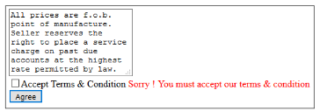
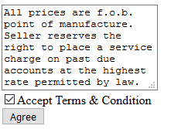
Output - CustomValidator Control

Slide 60

ValidationSummary Control
The ValidationSummary control is reporting control, which is used by the other validation controls on a page.
You can use this validation control to consolidate errors reporting for all the validation errors that occur on a page instead of leaving this up to each and every individual validation control.
The validation summary control will collect all the error messages of all the non-valid controls and put them in a list.
Example
<asp:ValidationSummary ID="valSummary" runat="server" ValidationGroup="Save" ForeColor="Red"/>

Slide 61
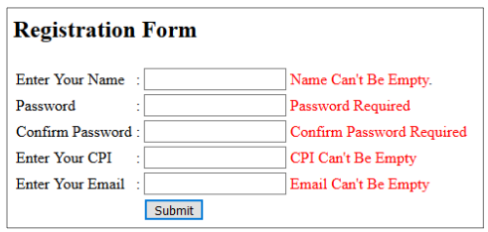
Example – Validation Control

Slide 62
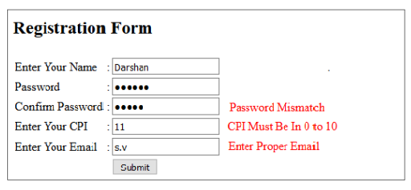
Example – Validation Control

Slide 63
Thank You
Looping

